Slide 1

Mental Health and Wellness Power Hour
Presented by: Thomas Faulkner

Slide 2

Getting Started
Learning Objectives
Understanding Mental Health and Wellness
Common Mental Health Challenges/Disorders
Coping Strategies
Stress Management
Building Resilience
Local Resources and Support
Q&A and Discussion

Slide 3

Setting the Learning Atmosphere
Creating a Safe Space
Courageous and Honest Conversations
Debating Ideas, Not Convictions
Respecting Dialogue
Sensitivity to Lived Experiences
Confidentiality
Sharing Knowledge
Have fun
Notes:
prompt user input on other ideas to set the learning atmosphere. Typically, people can tend to be more likely to self-disclose in these types of trainings. Be prepared/ready to handle those situations with a co-trainer or sensitive redirection and follow up.

Slide 4

Icebreaker Activity: The Counting Game
Instructions:
1. Divide the participants into two teams, Team A and Team B.
2. Flip a coin to determine which team goes first. Let's say Team A wins the coin toss and goes first.
3. Explain the rules to both teams:
- The objective is to count to 15 as a team without more than one person saying a number.
- No body language, gestures, or verbal cues other than eye contact can be used to indicate who will say the next number.
- If at any point, two or more people from the same team speak simultaneously, that team loses, and it's the other team's turn.
4. Team A starts, and they must begin counting. For example, one person might say "One," then use eye contact to signal the next person to say "Two," and so on.
5. Continue counting until the team reaches 15 without making a mistake. If they succeed, Team A wins this round.
6. If Team A makes a mistake (e.g., two people say a number simultaneously), Team B gets a chance to count to 15 using the same rules.

Slide 5

Understanding Mental Health
Mental health is a critical component of wider public health continuum and is as equally important as one’s physical health and overall wellness.
It refers to the state of well-being that enables people to:
Effectively cope with daily life stressors
Work productively
Maintain healthy relationships
Contribute positively to their communities
Notes:
Feel free to change the cowboy in therapy. It was a great icebreaker for my targeted populations and was a good laugh for some.

Slide 6
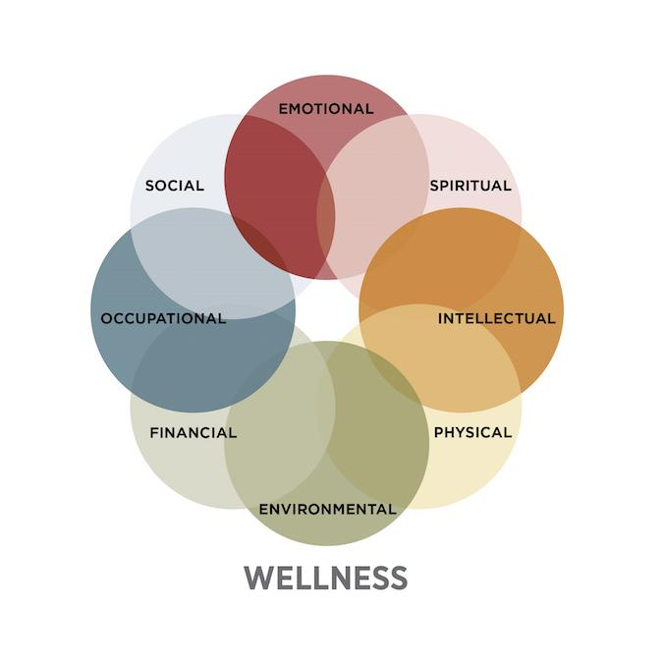
SAMHSA’s Eight Dimensions of Wellness

Slide 7

It’s Important to Make Time for Wellness
A challenge or disruption to wellness can be defined as any condition or circumstance that hinders an individual's ability to maintain optimal physical, mental, and emotional well-being.
Effects of Compromised Wellness:
Decline in overall health and well-being.
Reduced physical and mental resilience.
Increased vulnerability to illnesses and stress.
Impaired daily functioning and productivity.
Strain on relationships and social connections.
Elevated risk of chronic health conditions.
Reduced quality of life and life satisfaction.

Slide 8

Common Mental Health Disorders
Depression
- Persistent sadness, hopelessness, and loss of interest in activities.
- Common symptoms include changes in appetite, sleep disturbances, and fatigue.
- It affects people of all ages and can lead to physical health issues.
Anxiety
- Characterized by excessive worry, fear, and anxiety.
- Includes conditions like Generalized Anxiety Disorder, Panic Disorder, and Social Anxiety Disorder.
- Symptoms can range from restlessness and irritability to panic attacks.
Bipolar Disorder
- Alternates between manic episodes (elevated mood, high energy) and depressive episodes (low mood, fatigue).
- Can lead to impulsive behavior during manic phases.
- Requires ongoing management with mood stabilizers.
Schizophrenia
- Involves hallucinations, delusions, and disorganized thinking.
- Affects perception, thoughts, and social functioning.
- Typically diagnosed in late adolescence or early adulthood.
Post-Traumatic Stress Disorder
- Develops after exposure to a traumatic event.
- Symptoms include flashbacks, nightmares, and severe anxiety.
- Can affect anyone who has experienced trauma.
Substance Use Disorder
- Involves the misuse or dependence on substances like drugs or alcohol.
- Creates a strong compulsion to use despite harmful consequences.
- Treatment often involves detoxification and therapy.
Notes:
For informational purposes. Be sure to disclaimer that our role is not to diagnosis, but rather to understand generalized symptoms that fall under to know the best way to help.

Slide 9

Protective Factors

Slide 10

Coping Strategies
Conscious and purposeful efforts to manage, adapt to, or deal with stress, challenges, or difficult emotions.
Helps to regulate and improve emotional, mental, and psychological well-being in response to various life circumstances.
Coping strategies may vary from person to person based on preferences and experiences.
Some examples include:
Deep breathing
Meditation
Physical activity
Healthy eating
Adequate sleep
Journaling
Self-care
Practicing gratitude

Slide 11

Untraditional Coping Strategies
BBQ Smoke Meditation
Tubing the Frio/Guadalupe
Chopping Wood
Perfecting your Tex-Mex cooking
Slam back 32oz of Sweet Tea
Drive down a dirt road
Go to a Flea Market
Sit by a fire under the Texas stars
Mowing the grass
Pet your dog
Walking at Escondido Park
Notes:
This slide, you would want to customize to your targeted demographic. This sample was completed in rural South Texas.

Slide 12
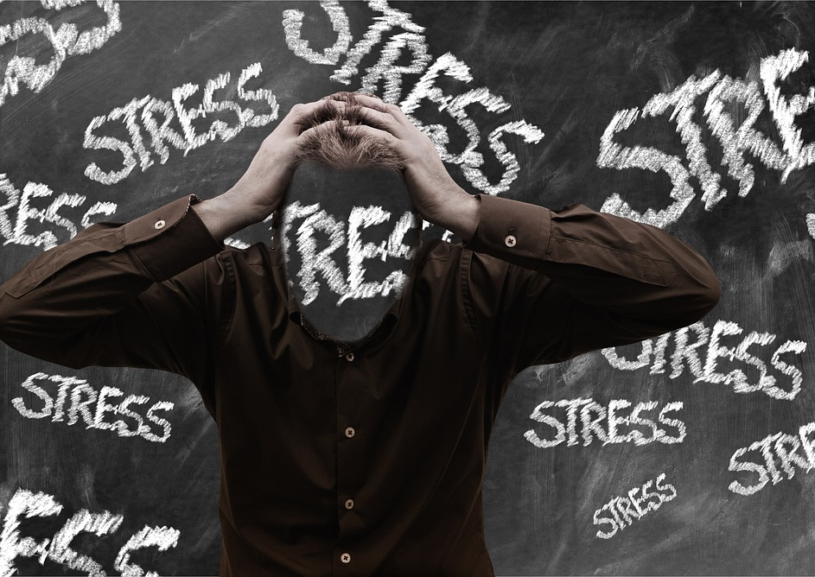
Managing Stress
Stress is the body's natural response to challenges, changes, or threats. It can be physical, emotional, or mental and affects everyone at some point.
Chronic stress can lead to physical and mental health issues
Effective stress management is crucial for maintaining overall well-being and preventing negative health effects.

Slide 13

Tips for Stress Management:
Identify Stressors: Recognize the sources of stress in your life.
Healthy Lifestyle: Maintain a balanced diet, regular exercise, and adequate sleep.
Learn to Say No: Set boundaries and prioritize self-care by declining additional commitments when necessary.
Relaxation Techniques: Practice deep breathing, meditation, or yoga.
Time Management: Prioritize tasks and set realistic goals.
Social Support: Seek help from friends and family when needed.
Mindfulness: Stay present in the moment and focus on what you can control.
Limit Stressors: Reduce exposure to unnecessary stressors when possible.
Seek Professional Help: Consult a therapist or counselor if stress becomes overwhelming.

Slide 14

Building Resilience
Resilience is the ability to adapt, bounce back, and maintain mental and emotional well-being in the face of adversity, stress, or challenging life events. It involves the capacity to withstand, recover from, and even grow through difficult experiences.
Why Resilience Matters for Mental Health:
Resilience is a fundamental factor in mental health because it empowers individuals to:
Reduce the negative impact of stressors on mental well-being.
Cope effectively with life's challenges and setbacks.
Bounce back from adversity with increased strength.
Promote emotional stability and psychological health.
Enhance the overall quality of life.

Slide 15

Building resilience is an ongoing process that involves developing various skills and adopting positive strategies.
Resilience can be likened to a pair of reliable work boots that you wear daily on the job. These boots provide protection by shielding your feet from sharp objects, rough terrain, and unexpected obstacles, much like resilience safeguards your mind and emotions during challenging life situations. Both resilience and work boots endure, withstanding wear and tear. While work boots enable you to work confidently and effectively, resilience empowers you to navigate life's challenges with confidence and adaptability. Like maintaining work boots, you can strengthen resilience through learning new coping skills, seeking support, and staying grounded in adversity. Both are essential companions on your journey, supporting your physical and mental well-being in different ways.

Slide 16

Other protective factors to consider include
Safe and stable environment
Spirituality
Strong social support
Optimism
Establish a sense of purpose
Supportive work environment
Access to mental health care
Conflict resolution/Problem solving skills

Slide 17


Local Supporting Resources
Employer Assistance Programs
Peer-Led Support Group
Online or In-person Educational Courses
Books and Self-Help Literature
Primary Care Physician
Thrift Stores
You are not alone!
Notes:
ID local resources in your area and provide those images in the ppt.

Slide 18

Q&A and Open Discussion

